Slide 1
Fitchburg State University
&
Massachusetts Association of Vocational Administrators
Master of Education
Curriculum & Teaching Program

Slide 2
Master of Education Program
Curriculum and Teaching, MEd (non-licensure)
Program designed to assist practicing educators in developing advanced skills in teaching, particularly in the area of curriculum development and adaptation for diverse learners, as well as enhancing your content knowledge in your field of licensure.

Slide 3
Program Overview
The MEd in Curriculum and Teaching is a non-licensure degree program designed to enhance teaching skills in key areas. However, for those students seeking to further their licensure with the Massachusetts Department of Elementary and Secondary Education (DESE), this program offers the flexibility to accumulate the required graduate-level credits in their teaching field and apply them to a master’s degree.
Earn your master's degree in as little as two years with flexible online classes.

Slide 4
For Vocational Teachers
You can apply all of your 6 OCED licensure courses (up to 18 credits) towards this program as long as you have taken the licensure courses at the graduate level for credit. You can also apply the 3 graduate credits from the SEI Endorsement Course.
In addition, if you have completed the MAVA Leadership Academy 1, you can apply the additional 6 graduate credits to this program.

Slide 5
This means……..
Instructors in the Vocational areas can use their Graduate Level licensure courses to fulfill up to 21 of the 36 credits required for the MEd in Curriculum and Teaching.
6 OCED licensure courses = 18 credits
1 SEI Endorsement course = 3 credits
Up to 21 Credits
Applied to this program

Slide 6
Curriculum and Teaching Program Plan of Study
18 Credits Core:
3cr Dynamic Perspectives in Education
3cr Course in Curriculum (licensure course)
6cr from two of the following areas:
Education Technology
Special Education (licensure course)
Literacy (or SEI)
3cr Research in Education
3cr Capstone
18 Credits Electives (including four licensure courses):
9cr Content
9cr Pedagogy
Total: 36 Credits

Slide 7
OCED Master of Education: Curriculum and Teaching
MAVA Plan of Study
Required CORE Courses
FSU Program Requirements | MAVA Licensure Courses
EDUC 9005 Dynamic Perspectives in Education (3)
A course in curriculum design/development (3) | OCED 7232 Dev Imp Standards Based Cur
A course in special education (3) | OCED 7230 Address Needs Students with Disabilities
A course on literacy development or technology relevant to the license under which the student is teaching (3) | SEI Course
EDUC 9300 Educational Research (3)
EDUC 9150 Capstone: Implementation of Best Practices (3)

Slide 8
MAVA Plan of Study (Cont.) Elective courses in Content and Pedagogy
Strand I Content Courses in Focus Area (9 credits)
Strand II Pedagogy Courses in Focus Area (9 credits)
Total number of Credits = 36
 | Proposed Courses for Vocational Teachers
Elective or transfer content course (3) | EDUC 7203 Using Technology to Enhance Student Achievement
Elective or transfer content course (3) | TBD per student interest
Elective or transfer content course (3) | OCED 7233 Teach Meth Using Res. Based Practices
 | Proposed Courses for Vocational Teachers
Elective or transfer pedagogy course (3) | OCED 7239 Sem Beg Voc Tech Teacher
Elective or transfer pedagogy course (3) | OCED 7240 Teaching Method: Educating and Assessing
Elective or transfer pedagogy course (3) | OCED 7238 Teach Meth Voc Tech

Slide 9
Chronological Sequence of Courses
MEd Courses | Date | Notes
EDUC 9005 Dynamic Perspectives in Education (3 cr.) | Spring 2023 | Will not be offered by MAVA again for 2 years
SPED 7024 Understanding Diversity and Disabilities (3 cr.) or | Summer 2023 | Will not be offered by MAVA again for 2 years
OCED 7230 Address Needs Students with Disabilities | ** | **Dependent on what is offered in your region
Licensure course * | Summer 2023 | Graduate licensure course offered in your region.*
EDUC 7203 Using Technology to Enhance Student Achievement (3 cr.) | Fall 2023 | Will not be offered by MAVA again for 2 years
Licensure course* | Fall 2023 | Graduate licensure course offered in your region.*
Google Classroom Course | Spring 2024 | Will not be offered by MAVA again for 2 years
Licensure course * | Spring 2024 | Graduate licensure course offered in your region.*
EDUC 9300 Educational Research (3 cr.) | Summer 2024 | Will not be offered by MAVA again for 2 years
Licensure course * | Summer 2024 | Graduate licensure course offered in your region.*
EDUC 9510 Capstone: Implementation of Best Practices (3 cr.) | Fall 2024 | Will not be offered by MAVA again for 2 years
Licensure course * | Fall 2024 | Graduate licensure course offered in your region.*
SEI course or elective (3 cr.) |  | SEI through the district OR an Elective (3 cr.)

Slide 10
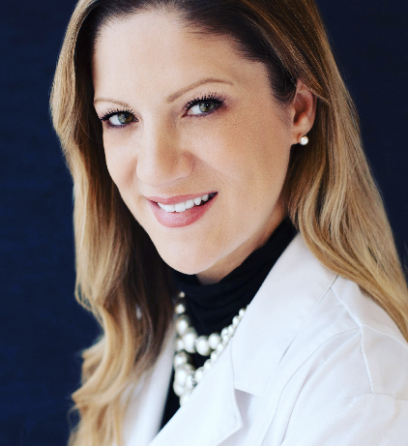
Endorsement from a Graduate
“My degree in Curriculum and Teaching from Fitchburg State gave me the boost I needed in the career path I have chosen. Everyone from the registrar to the professors was supportive in helping me attain my goal. They were there for me the entire time and wanted me to be successful. I was working during the program but with their support, I
was able to accomplish my goal. Thank you
Fitchburg State!” Angelica Corcoran , Vocational Teacher

Slide 11
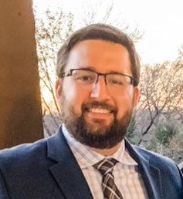
Endorsement from a Graduate
“As an academic teacher new to Massachusetts, the need to further my education and teaching license led me to Fitchburg State University’s Masters Degree program in Curriculum and Teaching through MAVA. The timing and availability of the courses allowed for me to work, coach, and complete my degree within 2 years. I was able to apply the information I learned in my courses directly into my classroom. Everyone was beyond helpful and made the entire process from my
matriculation to filling out my graduation
paperwork seamless. Thanks!”
Richard Chouinard

Slide 12
Admissions Process
Apply online: https://admissions.fitchburgstate.edu/apply
You will need to submit the following components:
Official transcript of Bachelor’s Degree
Official transcript of any Graduate Level Coursework (if applicable)
Graduate Credit Transfer Request and Course Descriptions (if applicable)
Professional Resume
Personal Statement
Three Letters of Recommendation
$50 Application Fee

Slide 13
Admissions Process (cont.)
Three Letters of Recommendation:
Recommenders should know you in a professional capacity, such as supervisors, colleagues, or teachers/professors.
List names and emails of recommenders in the online application.
An automatic email with the recommendation form is sent to them securely.
References fill it out, attach a recommendation, sign & submit the form which is automatically uploaded to the applicants file.
You can check the status of your application by logging back into your pending application. https://admissions.fitchburgstate.edu/apply/status

Slide 14
Course Discount
Courses can be taken through MAVA or Fitchburg State directly.
Courses will be at a discounted rate if taken through MAVA.

Slide 15
Prior Graduation Credits
Total of only 12 FSU graduate credits can be taken prior to acceptance. Please contact your advisor, Lynn D’Agostino, for questions.
And/or
Maximum 6 graduate credits from other institutions can be applied to your program.
(“3.0” minimum grade in transfer courses)

Slide 16
Apply ASAP as it takes time to compile the requirements and you do not want to lose credits!!!!
https://www.fitchburgstate.edu/academics/programs/curriculum-and-teaching-med-non-licensure

Slide 17
How long do I have to complete the program?
There is a six year window to complete this degree, with “the clock” beginning with the oldest course, including transfer courses.

Slide 18
MAVA Extended Campus Coordinator
Sheila Harrity, EdD
SheilaHarrity@mava.us
MAVA Program Advisor and
Curriuclum and Teaching Chair:
Lynn D’Agostino, EdD
ldagosti@fitchburgstate.edu
Graduate Admissions Counselor:
Brian Schremser
bschrems@fitchburgstate.edu
978-665-4041
Please contact Sheila Harrity or Lynn D’Agostino for more information on how to join the next MAVA Master of Education Curriculum & Teaching Program Cohort and for advice on course selection. Check out the Fitchburg State University website (https://www.fitchburgstate.edu/admissions/ or the MAVA website (https://www.mava.us/) for more information.

